Slide 1
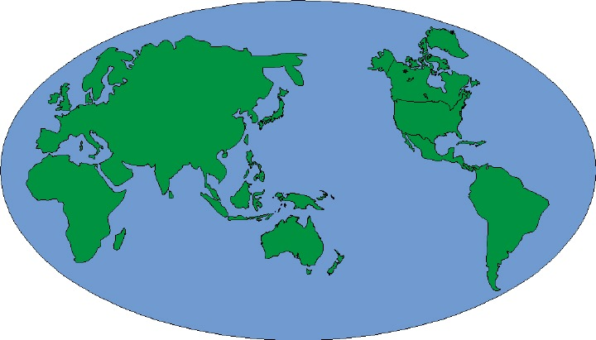

A Gospel Meeting
And He said to them, "Go into all the world and preach the gospel to every creature. (Mk. 16:15)
For since, in the wisdom of God, the world through wisdom did not know God, it pleased God through the foolishness of the message preached to save who believe. (1 Cor. 1:21)

Slide 2


Slide 3
Why Have A Gospel Meeting?
To save the lost (Rom. 1:16)
To strengthen the saved (Acts 2:42)
  Learn more of God’s Word (2 Tim. 4:2)
  Encourage one another (Heb. 3:12-13)
Who Should Attend?
Every member (Matt. 6:33; Heb. 10:25)
Those we invite (Rom. 3:23; Jn. 6:44-45)

Slide 4
Do not expect:
To be entertained
Food, fun or gimmicks
To be embarrassed
A collection to be taken up
What to expect?
Singing and Prayer
Gospel Preaching

