Slide 1

The Balance of Life
Give and…
…it will be given to you.
Then He said to them, “Take heed what you hear. With the same measure you use, it will be measured to you; and to you who hear, more will be given” (Mk. 4:24).
Give, and it will be given to you. A good measure, pressed down, shaken together and running over, will be poured into your lap. For with the measure you use, it will be measured to you (Lk. 6:38).

Slide 2
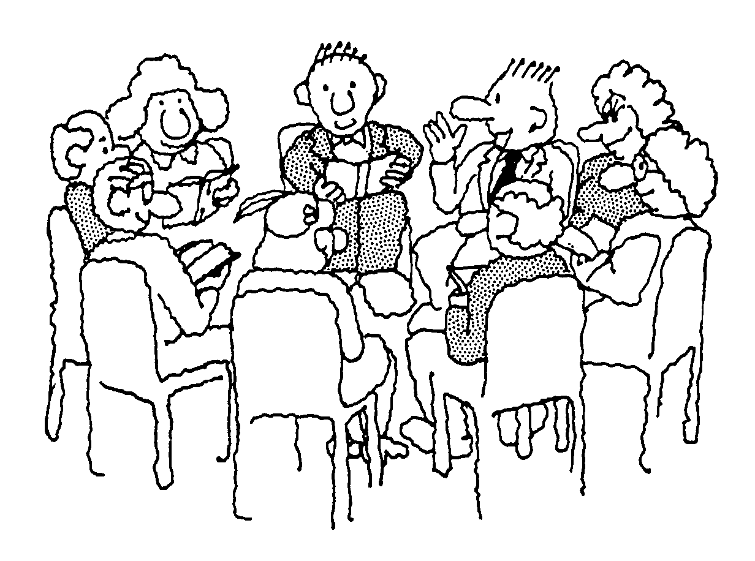

Study
The more study a person is prepared to give to any subject, the more he will get from it.
Especially true of Bible study.
Some bored with a study of God’s Word.
REASON: Do so little of it.
Others find it stimulating, interesting.
REASON: Do so much of it.
Do your best to present yourself to God as one approved, a workman who does not need to be ashamed and who correctly handles the word of truth (2 Tim. 2:15).
For Ezra had set his heart to study the Law of the LORD, and to do it and to teach his statutes and rules in Israel (Ezra 7:10).
For this very reason, make every effort to supplement your faith with virtue, and virtue with knowledge (2 Pet. 1:5).
Oh, how I love Your law!
It is my meditation all the day (Ps. 119:97).
But grow in the grace and knowledge of our Lord and Savior Jesus Christ (2 Pet. 3:18).

Slide 3

Worship
The more we bring to worship, the more we will get from it.
3 Wrong Ways To Come To Worship
Come entirely to get.
Come without expectation.
Come without preparation.
¹⁷In the following directives I have no praise for you, for your meetings do more harm than good.
¹⁸In the first place, I hear that when you come together as a church, there are divisions among you, and to some extent I believe it.
¹⁹No doubt there have to be differences among you to show which of you have God's approval.
²⁰When you come together, it is not the Lord's Supper you eat… (1 Cor. 11:17-20).
So I sent for you immediately, and it was good of you to come. Now we are all here in the presence of God to listen to everything the Lord has commanded you to tell us (Acts 10:33).

Slide 4

Christian Friends
The opposite of 1 Cor. 15:33 is true: Implies that good companionships strengthen good morals.
Get out of a relationship what we put into it.
Friendly, find other people friendly.
Irritable, finds others irritable.
Bad-tempered, find others bad-tempered.
A man who has friends must himself be friendly, but there is a friend who sticks closer than a brother (Prov. 18:24).

Slide 5
The Balance of Life
Is your life out of balance?
Do you find Bible study boring?
Is worship fulfilling to you?
Do you have good relationships with Christians?
Good for all of us to take a close personal inventory in regards to this principle.

