Slide 1
Believing A Lie – 1 Kings 13
Jeroboam sets up a new religion.
Did not trust God…
1 Kgs. 11:38 Then it shall be, if you heed all that I command you, walk in My ways, and do what is right in My sight, to keep My statutes and My commandments, as My servant David did, then I will be with you and build for you an enduring house, as I built for David, and will give Israel to you.

Slide 2
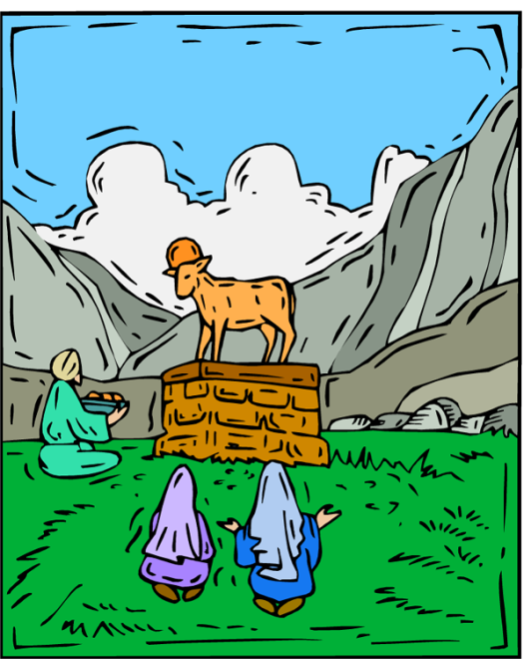
Believing A Lie – 1 Kings 13
1 Kgs. 12:26 And Jeroboam said in his heart, "Now the kingdom may return to the house of David: 27 If these people go up to offer sacrifices in the house of the LORD at Jerusalem, then the heart of this people will turn back to their lord, Rehoboam king of Judah, and they will kill me and go back to Rehoboam king of Judah.” 28 Therefore the king asked advice, made two calves of gold, and said to the people, “It is too much for you to go up to Jerusalem. Here are your gods, O Israel, which brought you up from the land of Egypt!” 29 And he set up one in Bethel, and the other he put in Dan.
⁵ Trust in the LORD with all your heart, And lean not on your own understanding; ⁶ In all your ways acknowledge Him, And He shall direct your paths. (Prov. 3).

Slide 3
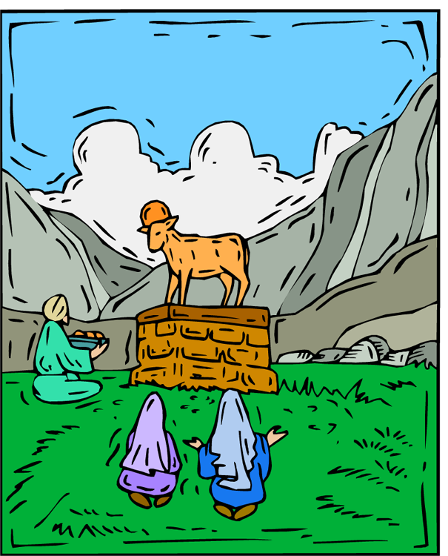
Believing A Lie – 1 Kings 13
1 Kgs. 12:30 Now this thing became a sin, for the people went to worship before the one as far as Dan. 31 He made shrines on the high places, and made priests from every class of people, who were not of the sons of Levi. 32 Jeroboam ordained a feast on the fifteenth day of the eighth month, like the feast that was in Judah, and offered sacrifices on the altar. So he did at Bethel, sacrificing to the calves that he had made. And at Bethel he installed the priests of the high places which he had made.

Slide 4
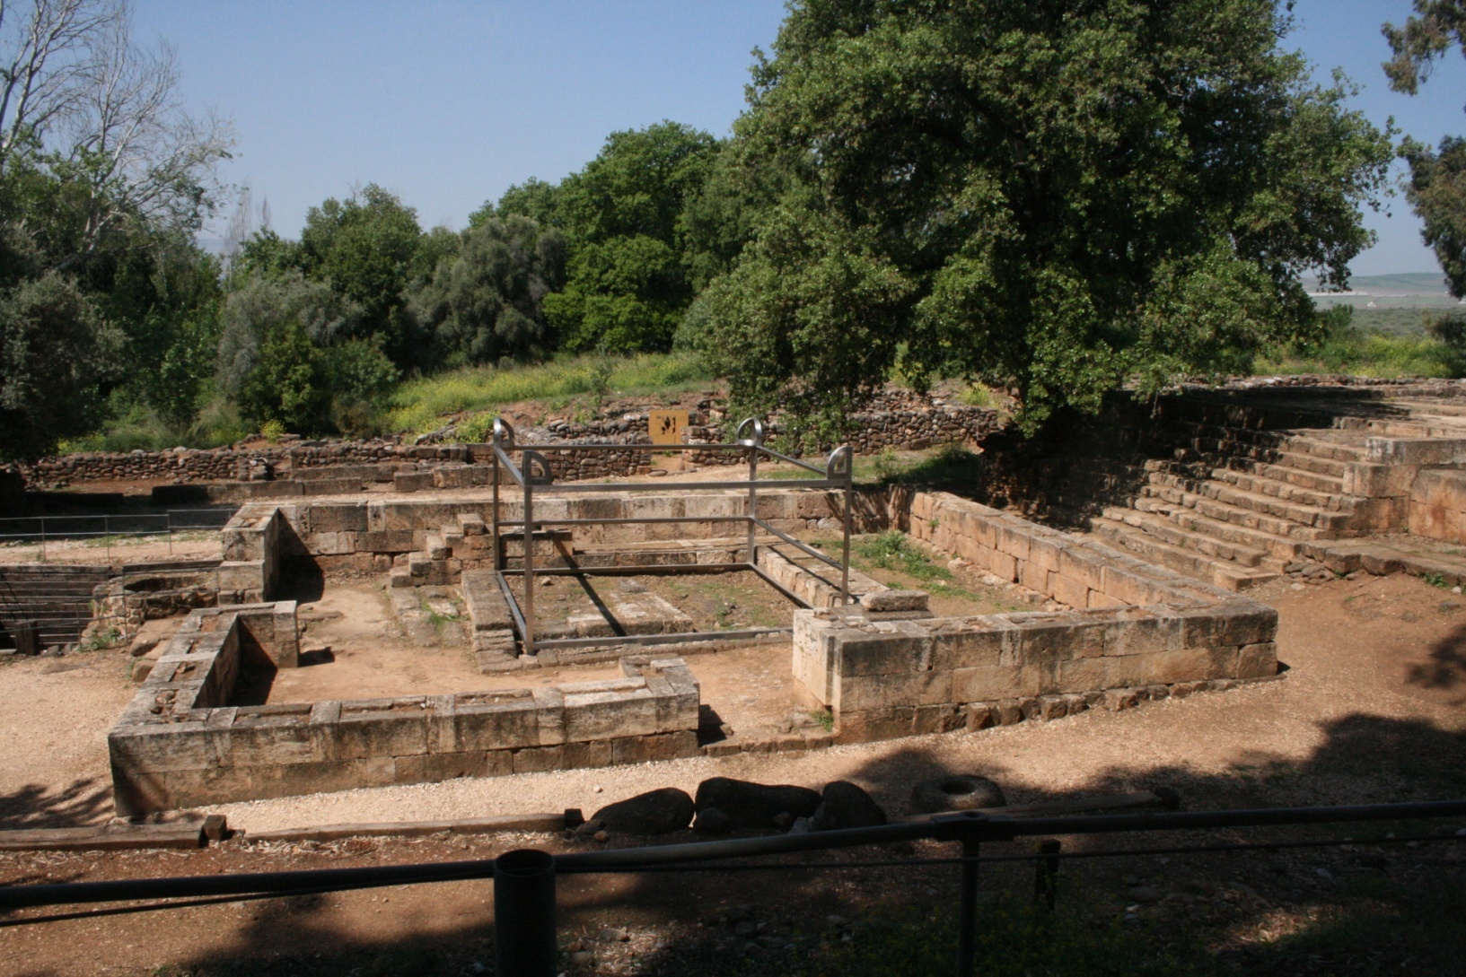
Altar at Dan

Slide 5
Appeal of False Religion
NEW
New innovative Worship
Contemporary Music
New programs—Fun.
CONVENIENT
Timed Services
No Extra Work
Let the Organization Do the Work
SIMILAR TO OLD –
But NOT the Same!!!

Slide 6
Believing A Lie – 1 Kings 13
Young man of God understood God’s command – repeated it to King (13:7-10).
Repeated it to old prophet (13:17).
1 Kgs. 13:18 He said to him, “I too am a prophet as you are, and an angel spoke to me by the word of the LORD, saying, ‘Bring him back with you to your house, that he may eat bread and drink water.’” But he lied unto him.

Slide 7
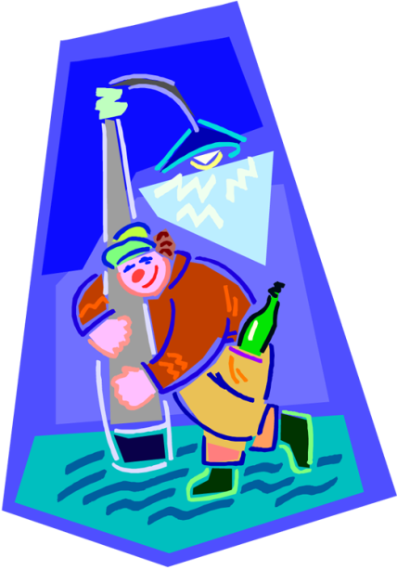
Lies Some Believe
“One drink won’t hurt you.”
God’s Wisdom in Prov. 23:31 Do not look on the wine when it is red, When it sparkles in the cup, When it swirls around smoothly:
Consequences of Not following God’s Wisdom:
Prov. 23:32 At the last it bites like a serpent, And stings like a viper. 33 Your eyes will see strange things, And your heart will utter perverse things. 34 Yes, you will be like one who lies down in the midst of the sea, Or like one who lies at the top of the mast, saying: 35 "They have struck me, but I was not hurt; They have beaten me, but I did not feel it. When shall I awake, that I may seek another drink?

Slide 8
Satan Deceives…
It the best life.
Missing out on life if you don’t drink.
All the right people drink—the fun people.
You can quit any time you get ready.
He doesn’t mention:
Abused wife and kids
Kids afraid of drunk parent
Traffic accidents, rapes, and assaults
Ruined lives, jobs lost
Embarrassed mate

Slide 9
God Warns…
1 Pet. 5:8 Be sober, be vigilant; because your adversary the devil walks about like a roaring lion, seeking whom he may devour.
1 Pet. 4:3 For we have spent enough of our past lifetime in doing the will of the Gentiles--when we walked in lewdness, lusts, drunkenness, revelries, drinking parties, and abominable idolatries.
Satan misuses John 2:1-11 and 1 Tim. 5:23 for his evil purposes.
Used by people who want to drink and seek to justify their sinful actions.

Slide 10
Lies Some Believe…
“I can miss services and it won’t hurt me.”
Whatever benefit you would have gained from attending is lost!
Whatever encouragement or exhortation you could have been to others is lost.
Then your unfaithfulness is used by Satan to discourage your brethren.
Heb. 10:24 And let us consider one another in order to stir up love and good works, 25 not forsaking the assembling of ourselves together, as is the manner of some, but exhorting one another, and so much the more as you see the Day approaching.
Matt. 6:33 But seek first the kingdom of God and His righteousness, and all these things shall be added to you.

Slide 11
Lies Some Believe…
“I can associate with ungodly people and it won’t cause me to sin.”
Seldom does anyone ever fall away at once.
It’s a slow, step by step process.
Satan works on you a little at a time.

Slide 12
Consider Your Association with the Ungodly
2 Sam. 13:3 But Amnon had a friend whose name was Jonadab the son of Shimeah, David's brother. Now Jonadab was a very crafty man.
1 Kgs. 11:1 But King Solomon loved many foreign women, as well as the daughter of Pharaoh: women of the Moabites, Ammonites, Edomites, Sidonians, and Hittites- 2 from the nations of whom the LORD had said to the children of Israel, "You shall not intermarry with them, nor they with you. Surely they will turn away your hearts after their gods." Solomon clung to these in love…. 4 For it was so, when Solomon was old, that his wives turned his heart after other gods; and his heart was not loyal to the LORD his God, as was the heart of his father David.
Jud. 16:16 And it came to pass, when she pestered him daily with her words and pressed him, so that his soul was vexed to death.
1 Cor. 15:33 Do not be deceived: Evil company corrupts good habits.

Slide 13
Lies Some Believe…
“It doesn’t matter what you watch or listen to.”
Matt. 14:6 But when Herod's birthday was celebrated, the daughter of Herodias danced before them and pleased Herod. 7 Therefore he promised with an oath to give her whatever she might ask.
Prov. 4:23 Keep your heart with all diligence, For out of it spring the issues of life.
Prov. 23:7 For as he thinks in his heart, so is he…

Slide 14
Lies Some Believe…
“It doesn’t matter what you watch or listen to.”
Mt 15:18 But those things which proceed out of the mouth come from the heart, and they defile a man. 19 For out of the heart proceed evil thoughts, murders, adulteries, fornications, thefts, false witness, blasphemies. 20 These are the things which defile a man, but to eat with unwashed hands does not defile a man."
Phil. 4:8 Finally, brethren, whatever things are true, whatever things are noble, whatever things are just, whatever things are pure, whatever things are lovely, whatever things are of good report, if there is any virtue and if there is anything praiseworthy--meditate on these things.

Slide 15
Lies Some Believe…
“Safe sex outside of marriage.”
Heb. 13:4 Marriage is honorable among all, and the bed undefiled; but fornicators and adulterers God will judge.
1Cor. 6:18 Flee sexual immorality. Every sin that a man does is outside the body, but he who commits sexual immorality sins against his own body.
Satan doesn’t tell you about:
Lowered self-esteem; shame.
Lost virginity – can’t ever get back.
Diseases and pregnancy o/s of marriage.

Slide 16
Lies Some Believe…
“Join the church of your choice.”
Implies God accepts our choice as long as we are sincere.
Implies that all churches are equal.
Was that God’s attitude toward Jeroboam’s new religion?
God had one system of worship
He expected the Israelites in the North to continue to worship as commanded in the Law of Moses.

Slide 17
Lies Some Believe…
We are not at liberty to choose:
The name (Matt. 16:18; Acts 20:28; Rom. 16:16)
Terms of admittance (Matt. 7:21; Acts 9:6; Mk. 16:16; Matt. 10:32; Acts 2:38).
Worship (Jn. 4:24—Acts 2:42; 20:7; Eph. 5:19)
Organization (Phil. 1:1)
Work (Eph. 4:12; 1 Tim. 3:15; 1 Cor. 16:1-2)
Different plants destroyed (Matt. 15:13).
Even some local churches in danger (Rev. 2:5).

Slide 18
Don’t Believe Lies (1 Thess. 5:21)
Trust in the Lord (Prov. 3:5-8).
Do not turn from His way (2 John 9):
⁹ Whoever transgresses and does not abide in the doctrine of Christ does not have God. He who abides in the doctrine of Christ has both the Father and the Son.
¹⁰ If anyone comes to you and does not bring this doctrine, do not receive him into your house nor greet him;
¹¹ for he who greets him shares in his evil deeds.

