Slide 1
Bible Baptism
Misunderstood & Abused by Religions
Improper Practices
Postponement
Method (sprinkling, pouring substituted)
Subjects:
Infants
Saved(?) people
These think they’ve obeyed, but haven’t.
What, Why, Who, & when about baptism

Slide 2
What We Learn From the Bible:
Is immersion in water
For remission of sins
Only proper subjects: penitent believers
Essential to salvation; therefore urgent
Examples in Acts will confirm these facts
Puts one in Christ

Slide 3
Why Study Baptism
Important (Jn. 3:3-5)
Not the only part, nor the most important (Jas. 2:10)
Because of world’s mistreatment of it (Matt. 15:1-14)
We need to understand it (2 Tim. 2:15)
We need to be reminded (2 Pet. 3:1-2)

Slide 4

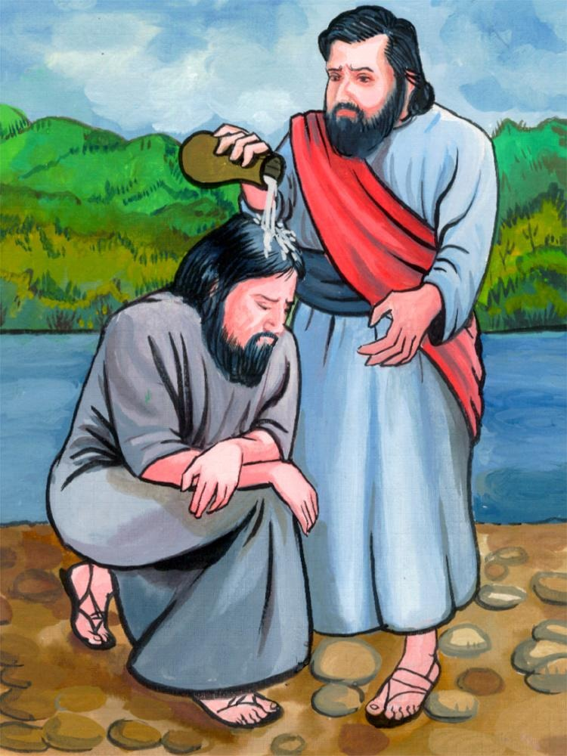
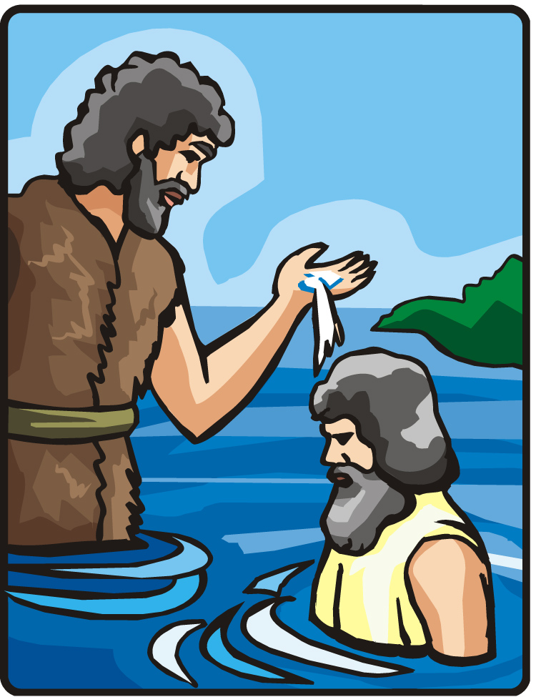
Immersion In Water
Requires much water (Jn. 3:23)
Burial (Rom. 6:3-4)
Ethiopian’s example (Acts 8:38-39)
Definition of baptism = immersion
Water (Acts 8:38-39; 10:47)

Slide 5
For Remission of Sins
It HAS a purpose
Stated by Christ (Mk. 16:16)
Repeated by Peter (Acts 2:38)
Taught by Ananias to Saul (Acts 22:16)
Necessity of obedience (1 Jn. 2:17; Matt 7:21)

Slide 6

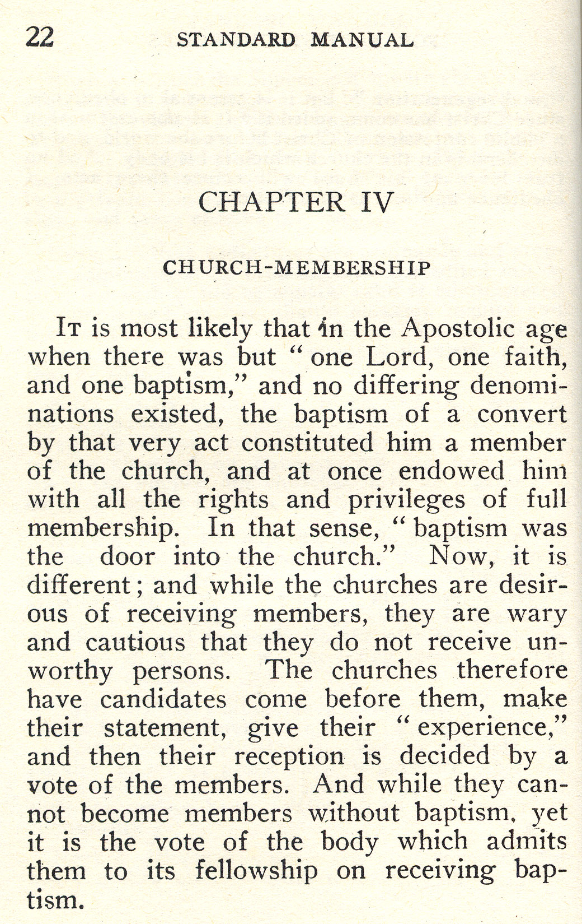
Denominational Teaching

Slide 7
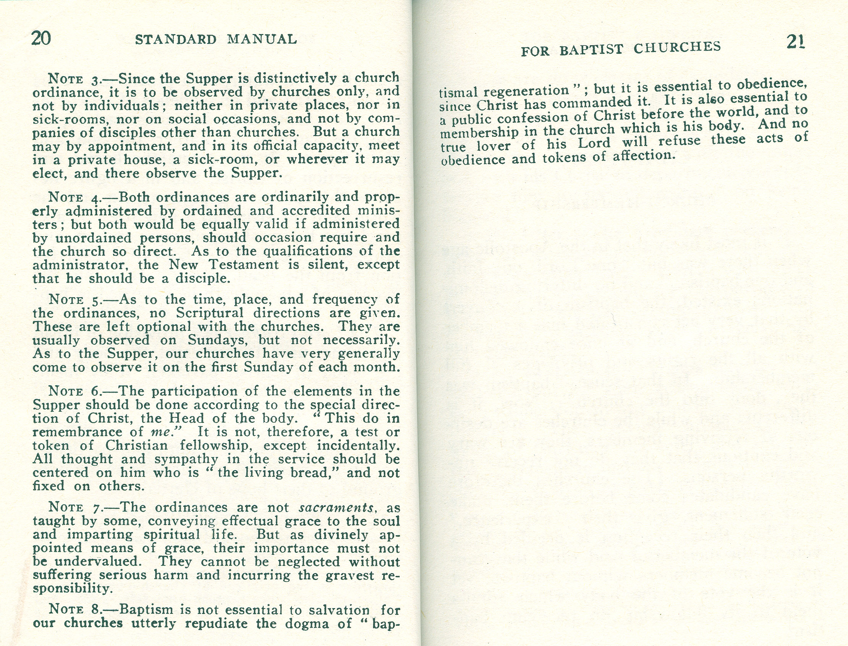
Denominational Teaching
Corresponding to that, baptism now saves you--not the removal of dirt from the flesh, but an appeal to God for a good conscience--through the resurrection of Jesus Christ (1 Pet. 3:21).

Slide 8
Only Proper Subjects
Believers (Mk. 16:15-16)
Penitent believers (Acts 2:38)
Those who willingly confess Christ (Acts 8:37)
Those who obey from the heart (Rom. 6:17)

Slide 9
Essential to Salvation: Urgent!
Baptism saves (1 Pet. 3:21)
Washes away sins (Acts 22:16)
Conscience cleansed (Heb. 9:14; 10:22)
Examples in Acts illustrate importance and urgency:
And he took them the same hour of the night and washed their stripes. And immediately he and all his family were baptized (Acts 16:33)

Slide 10
Conversions In Acts
Day of Pentecost (Acts 2:41)
Saul of Tarsus (Acts 9:18; 22:16)
Cornelius (Acts 10:47-48)
Lydia (Acts 16:15)
Philippian jailer (Acts 16:33)
Corinthians (Acts 18:8)

Slide 11
Puts One In Christ
Galatians in Christ through baptism (Gal. 3:27)
Corinthians baptized into body (1 Cor. 12:13)
Salvation is IN Christ (2 Tim. 2:10)
All spiritual blessings IN Christ (Eph. 1:3)

Slide 12
Doctrines of Men: Empty!
Infant baptism
No sins to cleanse (Ezek. 18:20; Matt. 18:3)
Incapable of belief (Mk. 16:16; Rom. 6:17)
Sprinkling or Pouring
Wrong action
Not practiced by faith (2 Cor. 5:7; Rom. 10:17)
A sign of salvation??? Why do it then?
Unnecessary: take it or leave it (Gal. 5:6; 3:27)
Saved by faith only (negates obedience)

Slide 13
Baptism Stands Between The Sinner And:
S
I
N
N
E
R
B
A
P
T
I
S
M
New Birth – Jn. 3:5
Salvation – Mk. 16:16
Remission of Sins – Acts 2:38
Sins Blotted Out – Acts 3:19
Sins Washed Away – Acts 22:16
Fellowship With Christ – Rom. 6:3-4
The Church – 1 Cor. 12:13
Answer of A Good Conscience – 1 Pet. 3:21

Slide 14
Conclusion
We have learned:
Is immersion in water
For remission of sins
Only proper subjects: penitent believers
Essential to salvation; therefore urgent
Examples in Acts confirm these facts
Puts one in Christ
Have Your Sins Been Washed Away?

