Slide 1
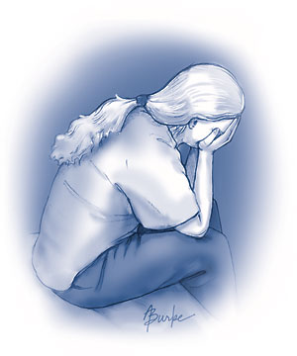
The Christian
and Depression
Proverbs 12:25
“Anxiety in the heart of man causes depression, but a good word makes it glad.”

Slide 2
Can a Christian be Depressed?
Salvation from our Sins (Acts 22:16)
Children of God (I John 3:1)
Every Spiritual Blessing (Eph. 1:3)
Always to be Rejoicing (Phil. 4:4)
Content in All Circumstances (4:11-12)
Eternal Reward in Heaven (2 Tim. 4:8)

Slide 3
The Christian and Depression
Job
Chapter 6:1-4; 7:11-12; 16:15-16; 17:1, 15; 30:16-19, 27-31
David
Psalm 142
Elijah
I Kings 19:1-10

Slide 4
The Christian and Depression
What causes depression?
Proverbs 12:25
Anxiety over a job loss
Anxiety over health problems
Anxiety over martial strife
Anxiety over wayward children
Anxiety over loss of a spouse (loneliness)
Anxiety over church troubles

Slide 5
The Christian and Depression
How does one Overcome it?
Don’t Worry about Tomorrow
Matt. 6:34, 27
Keep Busy in the Lord’s Work
I Kings 19:14-18; I Cor. 15:58

Slide 6
The Christian and Depression
How does one Overcome it?
Pray Earnestly
Philippians 4:6-7; I Peter 5:6-7
Meditate in the Scriptures
Psalm 119:49-50; Romans 15:4

Slide 7
The Christian and Depression
How does one Overcome it?
Support from Fellow Christians
Job 1:11-13; Col. 4:10-11; I Thess. 5:14
Always Look to Jesus
Heb. 12:1-2; 2 Tim. 4:16-17; Phil. 4:13

