Slide 1
Defending NT Doctrine
The latter do so in love, knowing that I am put here for the defense of the gospel (Phil. 1:16).

Slide 2
Secular Reasoning
“I have been COC for 30 years. I don't know anyone who thinks we're the only ones going to heaven. God alone decides who goes to heaven, and I don't presume to tell him his business. As for your statements about pitch﻿ pipes and microphones, a microphone is not music, playing a piano, etc is. The NT specifies what type of MUSIC is to be used in church--singing. We sing a cappella because that's what the first Christians did. Does God really care? Probably not. But that's what we want to do.”

Slide 3
Secular Reasoning
“My husband's family is in the church of Christ.﻿ Their last preacher did teach that they are the only ones going to heaven. They fired him so now the one they have supposedly does not teach that. I think it's okay not to have music accompaniment, but it's much prettier with it. I think God is pleased to hear beautiful and spiritual music. I don't think he'd curse a church that had a piano. But my grandparent's church rocks out with electric guitars. Whoa Nelly!”

Slide 4
Secular Reasoning
“I know that…my father is a preacher, I mean minister in the coc, but it does state in the bible to praise him with the tambourine and the trumpet, but you all don't worship by the old testament, but yet you still teach out of it.﻿ What sense does that make?”

Slide 5
Can Understand Why God Commands Study
¹²In fact, though by this time you ought to be teachers, you need someone to teach you the elementary truths of God's word all over again. You need milk, not solid food! ¹³Anyone who lives on milk, being still an infant, is not acquainted with the teaching about righteousness. ¹⁴But solid food is for the mature, who by constant use have trained themselves to distinguish good from evil (Heb. 5:12-14).
But grow in the grace and knowledge of our Lord and Savior Jesus Christ (2 Pet. 3:18).
Do your best to present yourself to God as one approved, a workman who does not need to be ashamed and who correctly handles the word of truth (2 Tim. 2:15).
If anyone speaks, he should do it as one speaking the very words of God… (1 Pet. 4:11).

Slide 6
Bible Questions Solved With Bible Study
“for thus it is written” (Matt. 2:5)
“It is written” (Matt. 4:1-11)
“just as it is written” (Acts 15:6-19)
“reasoned from the Scriptures” (Acts 17:2)
“according to the Scriptures” (1 Cor. 15:1-4)
The Right answer is in the Bible!
If we are going to truly convince someone to follow God, we must use the Scriptures!

Slide 7
“The Just Shall Live By Faith.” Romans 1:17
For we walk by faith, not by sight (2 Cor. 5:7).
So then faith comes by hearing, and hearing by the word of God (Rom. 10: 17).
But without faith it is impossible to please Him, for he who comes to God must believe that He is, and that He is a rewarder of those who diligently seek Him. By faith Noah, being divinely warned of things not yet seen, moved with godly fear, prepared an ark for the saving of his household, by which he condemned the world and became heir of the righteousness which is according to faith (Heb. 11:6-7).

Slide 8
Why?
Walk around Jericho 13 times in 7 days?
Carry Ark of the Covenant on poles?
Should Naaman dip in Jordan 7 times?
Sing in worship today?
Partake of L.S. Every 1st Day of Week?
Take up collection on 1st Day of Week?
But sanctify Christ as Lord in your hearts, always being ready to make a defense to everyone who asks you to give an account for the hope that is in you… (1 Pet. 3:15).

Slide 9
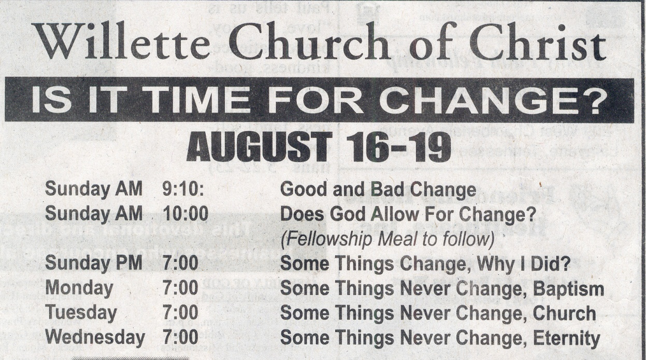
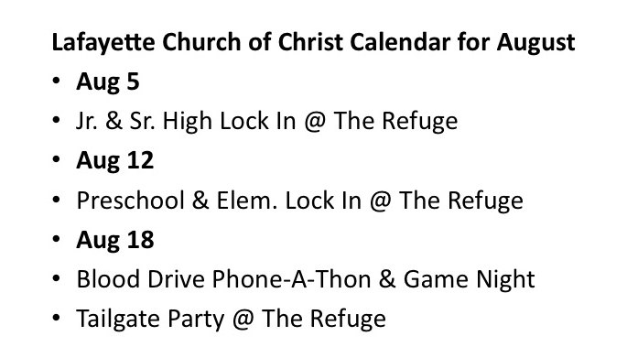
Why?
Pray to Mary?
Use a piano in worship?
Baptize?
Partake of L.S. once a month/year?
Have a “fellowship” meal?
Have a tailgate party?
Give to a sponsoring church?
But sanctify Christ as Lord in your hearts, always being ready to make a defense to everyone who asks you to give an account for the hope that is in you… (1 Pet. 3:15).

Slide 10
Defend Practice From Scriptures
1 Pet. 3:15
Phil. 1:16
2 Cor. 5:7
It’s my responsibility to give Scripture for what I am doing!

