Slide 1
Diligently Seeking Jesus
Matthew 9:27-31
27 When Jesus departed from there, two blind men followed Him, crying out and saying, “Son of David, have mercy on us!”
28 And when He had come into the house, the blind men came to Him. And Jesus said to them, “Do you believe that I am able to do this?” They said to Him, “Yes, Lord.”
29 Then He touched their eyes, saying, “According to your faith let it be to you.”
30 And their eyes were opened. And Jesus sternly warned them, saying, “See that no one knows it. ”
31 But when they had departed, they spread the news about Him in all that country.

Slide 2
Spiritually Blind
Prejudice, Ignorance, Preconceived Ideas; Apathetic
And in them the prophecy of Isaiah is fulfilled, which says:
Hearing you will hear and shall not understand,
And seeing you will see and not perceive;
For the hearts of this people have grown dull.
Their ears are hard of hearing,
And their eyes they have closed,
Lest they should see with their eyes and hear with their ears,
Lest they should understand with their hearts and turn,
So that I should heal them.
But blessed are your eyes for they see, and your ears for they hear (Matt. 13:14-16).

Slide 3
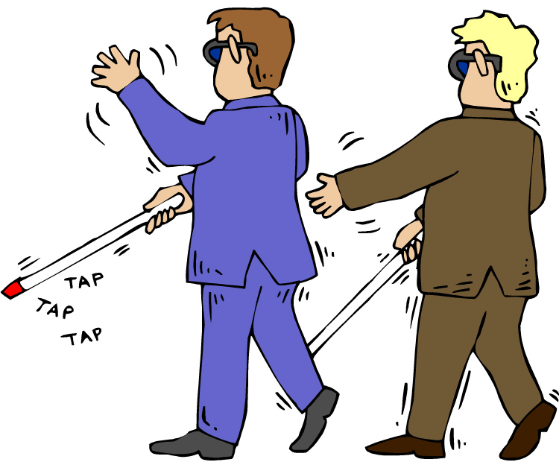
The Blind Men
Diligently Sought Jesus
Persevered: Overcame Obstacles!
Knew What They Needed: Mercy!
Honored Christ: “Son of David”

Slide 4
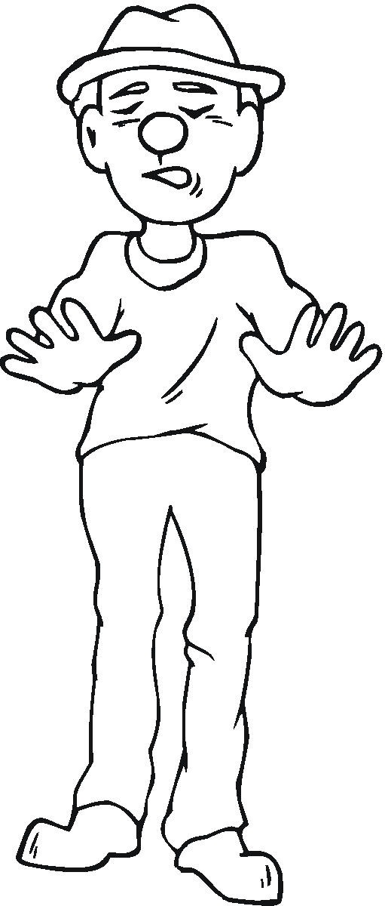
“Do you believe that I am able to do this?”
It concerned THEIR faith.
Faith is Important.
Why not immediately heal them?
  In this you greatly rejoice, though now for a little while, if need be, you have been grieved by various trials, that the genuineness of your faith, being much more precious than gold that perishes, though it is tested by fire, may be found to praise, honor, and glory at the revelation of Jesus Christ (1 Pet. 1:6-7).

Slide 5

Faith Is Important!
Without it we cannot please God (Heb. 11:6).
Because of its power to change a man’s heart:
  and made no distinction between us and them, purifying their hearts by faith (Acts 15:9).
  and asked letters from him to the synagogues of Damascus, so that if he found any who were of the Way, whether men or women, he might bring them bound to Jerusalem (Acts 9:2).
  Immediately he preached the Christ in the synagogues, that He is the Son of God (Acts 9:20).

Slide 6
“Do you believe that I am able to do this?”
It concerned THEIR faith.
Faith is Important.
Their faith was IN JESUS!

