Slide 1
Forgiveness
The LORD is merciful and gracious, Slow to anger, and abounding in mercy.
He will not always strive with us, Nor will He keep His anger forever.
He has not dealt with us according to our sins, Nor punished us according to our iniquities.
For as the heavens are high above the earth, So great is His mercy toward those who fear Him;
As far as the east is from the west, So far has He removed our transgressions from us.
As a father pities his children, So the LORD pities those who fear Him.
For He knows our frame; He remembers that we are dust. (Psalms 103:8-14)

Slide 2
God’s Forgiveness
Blessed is he whose transgression is forgiven, Whose sin is covered. Blessed is the man to whom the LORD does not impute iniquity, And in whose spirit there is no deceit. (Psa. 32:1-2)
But God demonstrates His own love toward us, in that while we were still sinners, Christ died for us. Much more then, having now been justified by His blood, we shall be saved from wrath through Him. (Rom. 5:8-9)
For by grace you have been saved through faith, and that not of yourselves; it is the gift of God, not of works, lest anyone should boast. (Eph. 2:8-9)

Slide 3
Our Forgiveness in Christ… We Must Forgive Others
And forgive us our debts, As we forgive our debtors. And do not lead us into temptation…For if you forgive men their trespasses, your heavenly Father will also forgive you. But if you do not forgive men their trespasses, neither will your Father forgive your trespasses. (Matt. 6:12-15)
From the Heart -- "So My heavenly Father also will do to you if each of you, from his heart, does not forgive his brother his trespasses." (Matt. 18:35)
Unlimited, Impartial -- "And if he sins against you seven times in a day, and seven times in a day returns to you, saying, 'I repent,' you shall forgive him." (Luke 17:4)

Slide 4
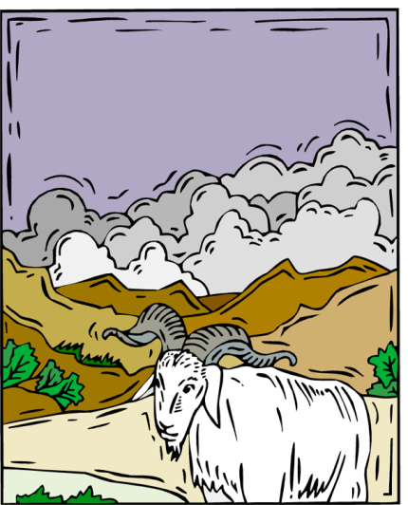
Understanding Forgiveness
To Send Away; To Release
Scapegoat (Lev. 16:8-22)
"So My heavenly Father also will do to you if each of you, from his heart, does not forgive his brother his trespasses." (Matt. 18:35)
Then Jesus said, "Father, forgive them, for they do not know what they do." And they divided His garments and cast lots. (Lk. 23:34)
When Jesus saw their faith, He said to the paralytic, "Son, your sins are forgiven you." (Mk. 2:5)

Slide 5
What Forgiveness Looks Like
Acknowledges the hurt caused by sin
And the LORD passed before him and proclaimed, "The LORD, the LORD God, merciful and gracious, longsuffering, and abounding in goodness and truth, keeping mercy for thousands, forgiving iniquity and transgression and sin, by no means clearing the guilty, visiting the iniquity of the fathers upon the children and the children's children to the third and the fourth generation." (Ex. 34:6-7)
Doesn’t dwell on the hurt (1 Cor. 13:4, 6)
God is hurt by our sins (Gen. 3:11; Mk. 3:5; Eph. 4:39)
Dwells on the remedy (Rom. 5:8; Lk. 17:3-4; Jas. 5:19-20)

Slide 6
What Forgiveness Looks Like
Releases the offender of his offense
Then Jesus said, "Father, forgive them, for they do not know what they do." And they divided His garments and cast lots. (Luke 23:34)
Eager to restore what has been damaged (Matt. 18:15)
For observe this very thing, that you sorrowed in a godly manner: What diligence it produced in you, what clearing of yourselves, what indignation, what fear, what vehement desire, what zeal, what vindication! In all things you proved yourselves to be clear in this matter. (2 Cor. 7:11)
God will punish for not forgiving others (Matt. 18:27-30, 34)

Slide 7
What Forgiveness Looks Like
Does Away With Resentment
Beloved, do not avenge yourselves, but rather give place to wrath; for it is written, "Vengeance is Mine, I will repay," says the Lord. Therefore "If your enemy is hungry, feed him; If he is thirsty, give him a drink; For in so doing you will heap coals of fire on his head." Do not be overcome by evil, but overcome evil with good. (Rom. 12:19-21)
If you meet your enemy's ox or his donkey going astray, you shall surely bring it back to him again. If you see the donkey of one who hates you lying under its burden, and you would refrain from helping it, you shall surely help him with it. (Ex. 23:4-5)

Slide 8
What Forgiveness Looks Like
Does Away With Resentment
The discretion of a man makes him slow to anger, And his glory is to overlook a transgression. (Prov. 19:11)
Joseph forgave his brothers (Gen. 50:16-21)
Let all bitterness, wrath, anger, clamor, and evil speaking be put away from you, with all malice. And be kind to one another, tenderhearted, forgiving one another, just as God in Christ forgave you. (Eph.4:31-32)

Slide 9
What Forgiveness Looks Like
Is An Act of Grace
In Him we have redemption through His blood, the forgiveness of sins, according to the riches of His grace (Eph. 1:7)
It is not deserved, yet it is freely offered:
"Come now, and let us reason together," Says the LORD, "Though your sins are like scarlet, They shall be as white as snow; Though they are red like crimson, They shall be as wool. If you are willing and obedient, You shall eat the good of the land; But if you refuse and rebel, You shall be devoured by the sword"; For the mouth of the LORD has spoken. (Isa. 1:18-20)

Slide 10
What Forgiveness Looks Like
Does Not Rejoice in Another Person’s Sins
Do not rejoice when your enemy falls, And do not let your heart be glad when he stumbles; Lest the LORD see it, and it displease Him, And He turn away His wrath from him. (Prov. 24:17-18)
Expresses Compassion
Then the master of that servant was moved with compassion, released him, and forgave him the debt. (Matt. 18:27)
Judge not, and you shall not be judged. Condemn not, and you shall not be condemned. Forgive, and you will be forgiven. Give, and it will be given to you: good measure, pressed down, shaken together, and running over will be put into your bosom. For with the same measure that you use, it will be measured back to you. (Luke 6:37-38)

