Slide 1


Influence of a Mate
He who finds a wife finds a good thing, And obtains favor from the LORD (Prov. 18:22).
An excellent wife, who can find? For her worth is far above jewels (Prov. 31:10).

Slide 2

Adam’s Wife: Eve
So when the woman saw that the tree was good for food, that it was pleasant to the eyes, and a tree desirable to make one wise, she took of its fruit and ate. She also gave to her husband with her, and he ate (Gen. 3:6).

Slide 3
Abraham’s Wife:
  So Sarai said to Abram, “See now, the LORD has restrained me from bearing children. Please, go in to my maid; perhaps I shall obtain children by her.” And Abram heeded the voice of Sarai (Gen. 16:2).
Job’s Wife:
  Then his wife said to him, “Do you still hold fast to your integrity? Curse God and die!” But he said to her, “You speak as one of the foolish women speaks. Shall we indeed accept good from God, and shall we not accept adversity?” In all this Job did not sin with his lips (Job 2:9-10).

Slide 4
Pilate’s Wife:
  While he was sitting on the judgment seat, his wife sent to him, saying, “Have nothing to do with that just Man, for I have suffered many things today in a dream because of Him” (Matt. 27:19).
Ananias & Sapphira:
  But a certain man named Ananias, with Sapphira his wife, sold a possession. And he kept back part of the proceeds, his wife also being aware of it, and brought a certain part and laid it at the apostles’ feet…. Then Peter said to her, “How is it that you have agreed together to test the Spirit of the Lord? (Acts 5:1-2, 11).

Slide 5
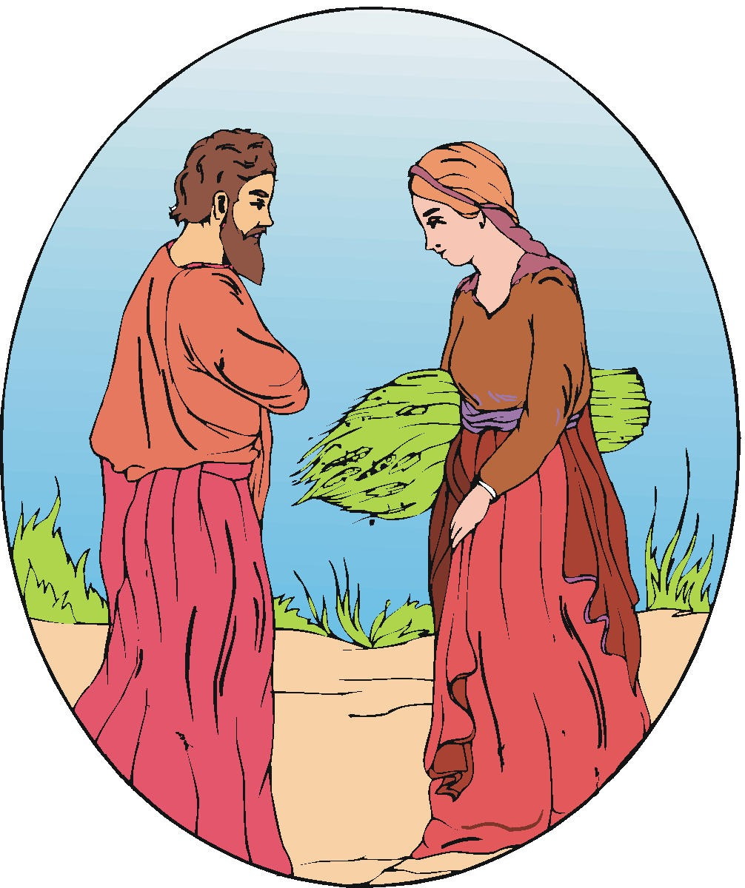
The Influence of a Mate
Samson and Delilah (Jud. 16)
Solomon (1 Kgs. 11:4)
Ahab and Jezebel (1 Kgs. 16:31; 21:7)
Esther and the king (Est. 5-8)

Slide 6
We Learn:
Sometimes we get good advice.
Sometimes we get bad advice.
We must always compare any advice with God’s Word.
  But Peter and the other apostles answered and said: “We ought to obey God rather than men” (Acts 5:29).
  Test all things; hold fast what is good (1 Thess. 5:21).
  Beloved, do not believe every spirit, but test the spirits, whether they are of God; because many false prophets have gone out into the world (1 Jn. 4:1).

Slide 7
Jesus Said:
Matt. 10:34 Do not think that I came to bring peace on earth. I did not come to bring peace but a sword.
35 For I have come to set a man against his father, a daughter against her mother, and a daughter-in-law against her mother-in-law;
36 and a man’s enemies will be those of his own household.
37 He who loves father or mother more than Me is not worthy of Me. And he who loves son or daughter more than Me is not worthy of Me.
38 And he who does not take his cross and follow after Me is not worthy of Me.

