Slide 1
Overcoming Discouragement
The Blues
Down & Out
In the Dumps
Frustrated
Depressed

Slide 2

God’s Message
Matt. 14:27 But Jesus immediately said to them: "Take courage! It is I. Don't be afraid.”
John 16:33 I have told you these things, so that in me you may have peace. In this world you will have trouble. But take heart! I have overcome the world.
Acts 23:11 The following night the Lord stood near Paul and said, "Take courage! As you have testified about me in Jerusalem, so you must also testify in Rome."

Slide 3

Universal Feeling At Times
Elijah
1 Kgs. 19:4 But he himself went a day's journey into the wilderness, and came and sat down under a broom tree. And he prayed that he might die, and said, "It is enough! Now, LORD, take my life, for I am no better than my fathers!”
David
Ps. 42:5 Why are you cast down, O my soul? And why are you disquieted within me? Hope in God, for I shall yet praise Him For the help of His countenance.
Ps. 42:6 O my God, my soul is cast down within me…

Slide 4

Some Causes
Illness
Paul – thorn in flesh (2 Cor. 12:7)
Epaphroditus – sick, nigh unto death (Phil. 2:27)
Timothy – stomach problems (1 Tim. 5:23)
Trophimus – sick (2 Tim. 4:20)
Job – boils (Job 2:7)
Be Patient and pray (2 Cor. 12:8-9)
Ask others to pray for you (Jas. 5:14-15)

Slide 5

Some Causes
Death of Loved One
Shunamite woman lost son (2 Kgs. 4:20)
David lost son (2 Sam. 12:18)
Mary & Martha lost brother (Jn. 11:14)
God will comfort us (2 Cor. 1:3-5; Ps. 147:3)
As a mother comforts (Isa. 66:13)
Through His Word (1 Thess. 4:18)
Through His people (Rom. 12:15)
Through prayer (1 Pet. 5:7)
God took Care of:
Mary & Martha (Jn. 11:35)
Widow of Nain (Lk. 7:11-18)
Friends of Dorcas (Acts 9:36-43)

Slide 6
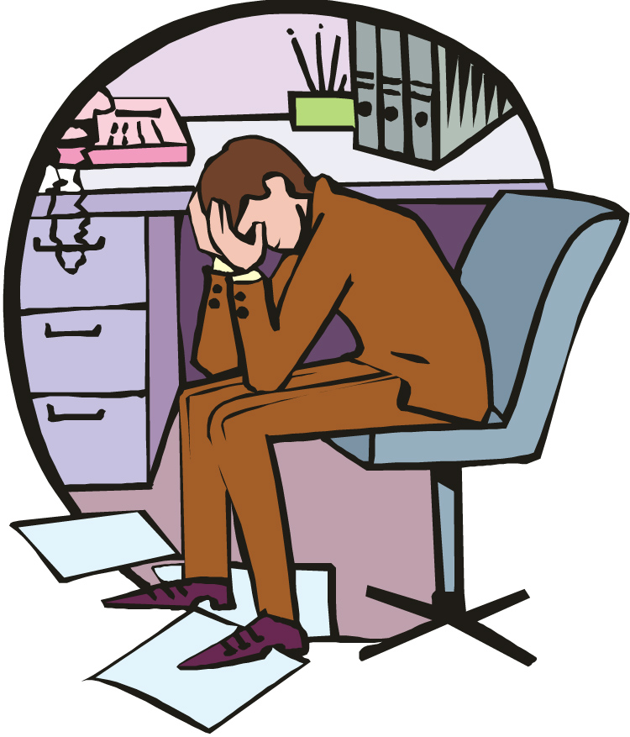
Some Causes
Material Losses
Job (Job 1 & 2)
Remember:
None of it is ours anyway (Hag. 2:8; 1 Cor. 4:7)
Going to leave it all one day (1 Tim. 6:7)
God will still provide our needs:
Matt. 6:33
Heb. 13:5
Ps. 37:27

Slide 7
Some Causes
Insecurity
Remember God Provides For Our Needs:
Ps. 37:25 I have been young, and now am old; Yet I have not seen the righteous forsaken, Nor his descendants begging bread.
Ps. 84:11 For the LORD God is a sun and shield; The LORD will give grace and glory; No good thing will He withhold From those who walk uprightly.
Phil. 4:19 And my God shall supply all your need according to His riches in glory by Christ Jesus.
God Provided For:
Widow of Zarephath (1 Kgs. 17:8-16)
Christ (Matt. 4:11)
The Multitude (Matt. 14:21)
The twelve & the seventy (Matt. 10:9-10; Lk. 10:4-7)
Israel in the wilderness (Ps. 78:23-29; Neh. 9:21)

Slide 8
Some Causes
Friends or Relatives Turn On you
Ps. 41:9 Even my own familiar friend in whom I trusted, Who ate my bread, Has lifted up his heel against me.
Demas forsook Paul (2 Tim. 4:10)
Remember:
Your friends & brethren who have not turned on you.
Prov. 18:24 A man who has friends must himself be friendly, But there is a friend who sticks closer than a brother.

Slide 9
Some Causes
Shattered Hopes or Dreams
Lost job, failed business
Downturn in financial markets
Remember:
Could turn into something fruitful (Acts 16:7-40)
Paul & Silas cast into prison resulted in Jailer ‘s conversion (Acts 16:23-34)

Slide 10
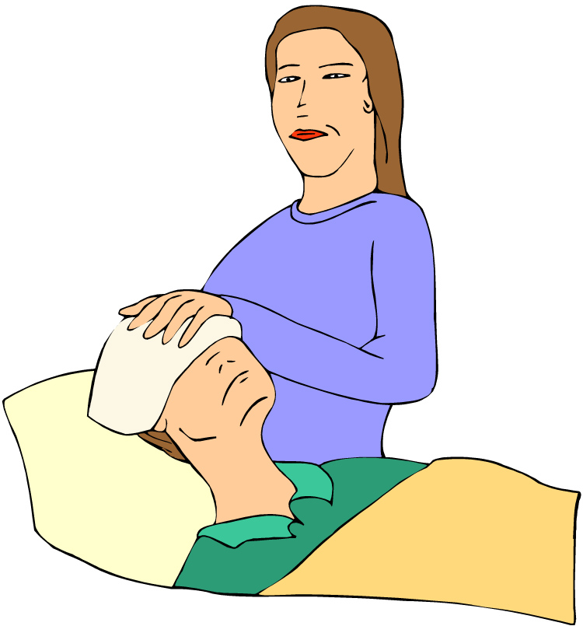
How Can We Overcome Discouragement?
Get Up, Get Out, & Do Something for Someone Else
God commanded Elijah to do (1 Kgs, 19:15-21).
Are causes bigger than self to be engaged in (Matt. 10:39).
Paul and Silas converted Jailer (Acts 15:23-33).

Slide 11
How Can We Overcome Discouragement?
Trust the Promises of God
Ps. 42:5 Why are you in despair, O my soul? And why have you become disturbed within me? Hope in God, for I shall again praise Him For the help of His presence.
Isa. 26:3-4 You will keep him in perfect peace, Whose mind is stayed on You, Because he trusts in You. Trust in the LORD forever, For in YAH, the LORD, is everlasting strength.

Slide 12
How Can We Overcome Discouragement?
Trust the Promises of God
Isa. 40:28-31 Have you not known? Have you not heard? The everlasting God, the LORD, The Creator of the ends of the earth, Neither faints nor is weary. His understanding is unsearchable.
²⁹ He gives power to the weak, And to those who have no might He increases strength.
³⁰ Even the youths shall faint and be weary, And the young men shall utterly fall,
³¹ But those who wait on the LORD Shall renew their strength; They shall mount up with wings like eagles, They shall run and not be weary, They shall walk and not faint.

Slide 13
How Can We Overcome Discouragement?
Think: Blessings Can Come From Burdens
Jas. 1:2-4 My brethren, count it all joy when you fall into various trials, knowing that the testing of your faith produces patience. But let patience have its perfect work, that you may be perfect and complete, lacking nothing.
Rom. 5:3-5 And not only that, but we also glory in tribulations, knowing that tribulation produces perseverance; and perseverance, character; and character, hope. Now hope does not disappoint, because the love of God has been poured out in our hearts by the Holy Spirit who was given to us.

Slide 14
How Can We Overcome Discouragement?
Use Burdens To Help Others
Phil. 1:12 But I want you to know, brethren, that the things which happened to me have actually turned out for the furtherance of the gospel.
2 Cor. 4:16-18 Therefore we do not lose heart. Even though our outward man is perishing, yet the inward man is being renewed day by day. For our light affliction, which is but for a moment, is working for us a far more exceeding and eternal weight of glory, while we do not look at the things which are seen, but at the things which are not seen. For the things which are seen are temporary, but the things which are not seen are eternal.

Slide 15
How Can We Overcome Discouragement?
Get Some Rest
1 Kgs. 19:3-4 And when he saw that, he arose and ran for his life, and went to Beersheba, which belongs to Judah, and left his servant there. But he himself went a day’s journey into the wilderness, and came and sat down under a broom tree. And he prayed that he might die, and said, “It is enough! Now, LORD, take my life, for I am no better than my fathers!”
Mk. 6:31 And He said to them, “Come aside by yourselves to a deserted place and rest a while.” For there were many coming and going, and they did not even have time to eat.

Slide 16
How Can We Overcome Discouragement?
Encourage Yourself; Conquer Self-pity
Matt. 9:20-21 And suddenly, a woman who had a flow of blood for twelve years came from behind and touched the hem of His garment. For she said to herself, “If only I may touch His garment, I shall be made well.”
Matt. 16:24 Then Jesus said to His disciples, “If anyone desires to come after Me, let him deny himself, and take up his cross, and follow Me.”
Gal. 2:20 I have been crucified with Christ; it is no longer I who live, but Christ lives in me; and the life which I now live in the flesh I live by faith in the Son of God, who loved me and gave Himself for me.

Slide 17
How Can We Overcome Discouragement?
Accept Fact: You Are of Value
“I am of no value to anyone.”
“No one cares about me.”
Matt. 10:31 Do not fear therefore; you are of more value than many sparrows.
Even “one talent” man was needed (Mt. 25:14-30).
In the Body of Christ EVERY member is import (1 Cor. 12:13-27).

Slide 18
How Can We Overcome Discouragement?
Be An Encourager
Lk. 22:32 But I have prayed for you, that your faith should not fail; and when you have returned to Me, strengthen your brethren.
1 Thess. 5:11-14 Therefore comfort each other and edify one another, just as you also are doing. And we urge you, brethren, to recognize those who labor among you, and are over you in the Lord and admonish you, and to esteem them very highly in love for their work’s sake. Be at peace among yourselves. Now we exhort you, brethren, warn those who are unruly, comfort the fainthearted, uphold the weak, be patient with all.

Slide 19
How Can We Overcome Discouragement?
Be An Encourager
Heb. 10:24 And let us consider one another in order to stir up love and good works.
Isa. 35:3-4 Strengthen the weak hands, And make firm the feeble knees. Say to those who are fearful-hearted,
“Be strong, do not fear!
Behold, your God will come with vengeance,
With the recompense of God;
He will come and save you.”

Slide 20
How Can We Overcome Discouragement?
Remember: Your Are Never Alone
1 Pet. 3:12-14 For the eyes of the LORD are on the righteous, And His ears are open to their prayers; But the face of the LORD is against those who do evil.”[ And who is he who will harm you if you become followers of what is good? But even if you should suffer for righteousness’ sake, you are blessed. “And do not be afraid of their threats, nor be troubled.”
Heb. 13:5-6 Let your conduct be without covetousness; be content with such things as you have. For He Himself has said, “I will never leave you nor forsake you.” So we may boldly say: “The LORD is my helper; I will not fear. What can man do to me?”

Slide 21
How Can We Overcome Discouragement?
Remember: Your Are Never Alone!
Matt. 28:19-20 Go therefore and make disciples of all the nations, baptizing them in the name of the Father and of the Son and of the Holy Spirit, teaching them to observe all things that I have commanded you; and lo, I am with you always, even to the end of the age.
Dan. 3:25 “Look!” he answered, “I see four men loose, walking in the midst of the fire; and they are not hurt, and the form of the fourth is like the Son of God.”
Ps. 23:4 Yea, though I walk through the valley of the shadow of death, I will fear no evil; For You are with me; Your rod and Your staff, they comfort me.

Slide 22
How Can We Overcome Discouragement?
Remember: Every Cause of Discouragement is Only Temporary!
Ps. 3:5 …Weeping may endure for a night, But joy comes in the morning.
Remember: You Can Overcome Temptation!
1 Cor. 10:13 No temptation has overtaken you except such as is common to man; but God is faithful, who will not allow you to be tempted beyond what you are able, but with the temptation will also make the way of escape, that you may be able to bear it.

Slide 23
How Can We Overcome Discouragement?
Pray
1 Sam. 30:6-8 Now David was greatly distressed, for the people spoke of stoning him, because the soul of all the people was grieved, every man for his sons and his daughters. But David strengthened himself in the LORD his God…. and David inquired of the LORD.
1 Sam. 1:10 In bitterness of soul Hannah wept much and prayed to the LORD.
Phil. 4:6-7 Be anxious for nothing, but in everything by prayer and supplication, with thanksgiving, let your requests be made known to God; and the peace of God, which surpasses all understanding, will guard your hearts and minds through Christ Jesus.

Slide 24
Never Give Up!
Matt. 24:13 But he who endures to the end shall be saved.
2 Tim. 4:5 But you be watchful in all things, endure afflictions, do the work of an evangelist, fulfill your ministry.
Jas. 5:11 Indeed we count them blessed who endure. You have heard of the perseverance of Job and seen the end intended by the Lord—that the Lord is very compassionate and merciful.
Heb. 11:27 By faith he forsook Egypt, not fearing the wrath of the king; for he endured as seeing Him who is invisible.

