Slide 1
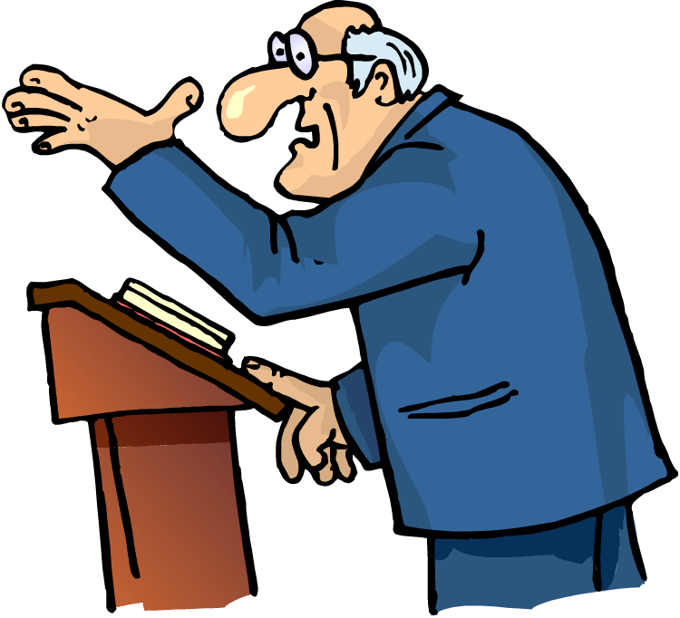
Preachers
Want to be effective; Save the lost
We must be careful not to adopt:
The latest (unscriptural) trends of the day.
The desire to be liked; praise of men.
Preaching that pleases people and not God.
But as we have been approved by God to be entrusted with the gospel, even so we speak, not as pleasing men, but God who tests our hearts. (1 Thess. 2:4)

Slide 2
Preaching Like Elijah
When Jesus came into the region of Caesarea Philippi, He asked His disciples, saying, Who do men say that I, the Son of Man, am? So they said, Some say John the Baptist, some Elijah, and others Jeremiah or one of the prophets (Matt. 16:13-14).
Behold, I will send you Elijah the prophet Before the coming of the great and dreadful day of the LORD (Mal. 4:5).
But I say to you that Elijah has come already, and they did not know him but did to him whatever they wished. Likewise the Son of Man is also about to suffer at their hands (Matt. 17:12).
Christ

Slide 3
Concern For Lost Souls
Now as He drew near, He saw the city and wept over it. (Luke 19:41)
Now while Paul waited for them at Athens, his spirit was provoked within him when he saw that the city was given over to idols. (Acts 17:16)
I am the good shepherd. The good shepherd gives His life for the sheep. (John 10:11)
Therefore My Father loves Me, because I lay down My life that I may take it again. No one takes it from Me, but I lay it down of Myself. I have power to lay it down, and I have power to take it again. This command I have received from My Father. (John 10:17-18)
Greater love has no one than this, than to lay down one’s life for his friends. (John 15:13)
Christ

Slide 4
Concern For Lost Souls
Now therefore, send and gather all Israel to me on Mount Carmel, the four hundred and fifty prophets of Baal, and the four hundred prophets of Asherah, who eat at Jezebel's table. So Ahab sent for all the children of Israel, and gathered the prophets together on Mount Carmel. And Elijah came to all the people, and said, How long will you falter between two opinions? If the LORD is God, follow Him; but if Baal, follow him. But the people answered him not a word. (1 Kgs. 18:19-21)
For the love of Christ compels us, because we judge thus: that if One died for all, then all died; and He died for all, that those who live should live no longer for themselves, but for Him who died for them and rose again. (2 Cor. 5:14-15)
Elijah

Slide 5
Concern For Lost Souls
Matt. 28:19-20 – Go…
John 9:4 – We Must Work…
Romans 1:15 – I am ready…As much as in me is.
Therefore those who were scattered went everywhere preaching the word. (Acts 8:4)

Slide 6
Willingness To Confront Error
Then it happened, when Ahab saw Elijah, that Ahab said to him, “Is that you, O troubler of Israel?” And he answered, “I have not troubled Israel, but you and your father's house have, in that you have forsaken the commandments of the LORD and have followed the Baals. Now therefore, send and gather all Israel to me on Mount Carmel, the four hundred and fifty prophets of Baal, and the four hundred prophets of Asherah, who eat at Jezebel's table.” (1 Kings 18:17-19)
So Ahab said to Elijah, “Have you found me, O my enemy?” And he answered, “I have found you, because you have sold yourself to do evil in the sight of the LORD.” (1 Kings 21:20)
Elijah

Slide 7
Willingness To Confront Error
Challenged Those In Error – Mark 3:1-6
Cleansed Temple – Mark 11:15
Authority Questioned – Mark 11:28
Parable of Vinedressers – Mark 12:1-12
Questioned About Taxes – Mark 12:13-17
Questioned About Resurrection – Mk. 12:18-27
Greatest Commandment Question – Mk. 12:28-31
Jesus Questioned Them – Mark 12:35-37
Result – Common People Heard Him Gladly!
Christ

Slide 8
Willingness To Confront Error
But Saul increased all the more in strength, and confounded the Jews who dwelt in Damascus, proving that this Jesus is the Christ. (Acts 9:22)
But when they departed from Perga, they came to Antioch in Pisidia, and went into the synagogue on the Sabbath day and sat down. (Acts 13:14)
“…and by Him everyone who believes is justified from all things from which you could not be justified by the law of Moses.” (Acts 13:39)
But the Jews stirred up the devout and prominent women and the chief men of the city, raised up persecution against Paul and Barnabas, and expelled them from their region. (Acts 13:50)
Paul

Slide 9
Willingness To Confront Error
And Elijah came to all the people, and said, “How long will you falter between two opinions? If the LORD is God, follow Him; but if Baal, follow him.” But the people answered him not a word. (1 Kings 18:21)
So they took the bull which was given them, and they prepared it, and called on the name of Baal from morning even till noon, saying, “O Baal, hear us!” But there was no voice; no one answered. Then they leaped about the altar which they had made. And so it was, at noon, that Elijah mocked them and said, “Cry aloud, for he is a god; either he is meditating, or he is busy, or he is on a journey, or perhaps he is sleeping and must be awakened.” (1 Kings 18:26-27)
Elijah

Slide 10
Willingness To Confront Error
There Is A Right and Wrong In Religion!
Denominational Church or Christ’s Church?
Baptism – Essential or Non-essential?
Music – Vocal, Instrumental, or Both?
Methodist Church or Church of Christ--Which Is Right?
Scriptural: Name? Origin? Practice?
Both Cannot Be Right!
Different: Name, Doctrine, Practice, Origin, Organization, Worship, etc.
Today

Slide 11
Dealt With False Teachers Severely
And Elijah said to them, “Seize the prophets of Baal! Do not let one of them escape!” So they seized them; and Elijah brought them down to the Brook Kishon and executed them there. (1 Kings 18:40)
WHY?
But that prophet or that dreamer of dreams shall be put to death, because he has spoken in order to turn you away from the LORD your God, who brought you out of the land of Egypt and redeemed you from the house of bondage, to entice you from the way in which the LORD your God commanded you to walk. So you shall put away the evil from your midst. (Deut. 13:5)
Elijah
But the prophet who presumes to speak a word in My name, which I have not commanded him to speak, or who speaks in the name of other gods, that prophet shall die. (Deuteronomy 18:20)

Slide 12
Dealt With False Teachers Severely
Cleansed the Temple – John 2:13-17; Matt. 21:12
Warned of Causing Offenses – Matt. 18:7
Severely Rebuked Religious Leaders – Matt. 23
Offended Pharisees – Matt. 15:12-14
Shamed His Adversaries – Luke 13:10-17
Taught Us How To Identify – Matt. 7:15-20
Christ

Slide 13
Dealt With False Teachers Severely
Taught Us How To Treat Them –
Rev. 2:14-17 -- Hate false doctrine & fight against
Rev. 2:20-23, 29 -- Demand repentance
Titus 3:10 -- Admonish, then reject
2 John 9-11 -- Do not receive
1 Tim. 6:3-5 -- Withdraw yourself
Rom. 16:17 -- Mark & avoid
1 Tim. 1:20 -- Deliver to Satan
Titus 1:9-11 -- Convict & stop their mouths
Christ

Slide 14
Falsely Accused & Mistreated
Then it happened, when Ahab saw Elijah, that Ahab said to him, “Is that you, O troubler of Israel?” (1 Kings 18:17)
So Ahab said to Elijah, “Have you found me, O my enemy?” And he answered, “I have found you, because you have sold yourself to do evil in the sight of the LORD.” (1 Kings 21:20)
Same Happened To Jesus
And they began to accuse Him, saying, “We found this fellow perverting the nation, and forbidding to pay taxes to Caesar, saying that He Himself is Christ, a King.” (Luke 23:2)
Elijah
Christ

Slide 15
Falsely Accused & Mistreated
And at that time Hanani the seer came to Asa king of Judah, and said to him: “Because you have relied on the king of Syria, and have not relied on the LORD your God, therefore the army of the king of Syria has escaped from your hand…For the eyes of the LORD run to and fro throughout the whole earth, to show Himself strong on behalf of those whose heart is loyal to Him. In this you have done foolishly; therefore from now on you shall have wars.” (2 Chron. 16:7-9)
Then Asa was angry with the seer, and put him in prison, for he was enraged at him because of this…(2 Chron. 16:10)
Because John had said to him, “It is not lawful for you to have her.” And although he wanted to put him to death, he feared the multitude, because they counted him as a prophet. (Matt. 14:4-5)
Hanani
John the Baptizer

Slide 16
Elijah & Christ Both Obeyed God!
Elijah →Go
Elijah → Went
Elijah → Speak
Elijah → Spoke
For I have come down from heaven, not to do My own will, but the will of Him who sent Me. (Jn. 6:38)
And being found in appearance as a man, He humbled Himself and became obedient to the point of death, even the death of the cross. (Phil. 2:8)
And having been perfected, He became the author of eternal salvation to all who obey Him. (Heb. 5:9)
Elijah
Christ

Slide 17
Preaching Like Elijah
Concern for lost souls
Willingness to confront error
Dealt severely with false teachers
Endure false accusations
Obeyed God

