Slide 1
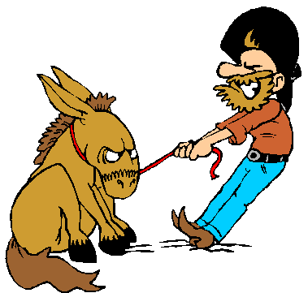
Stubbornness
For rebellion is as the sin of witchcraft, And stubbornness is as iniquity and idolatry. Because you have rejected the word of the LORD, He also has rejected you from being king (1 Sam. 15:23).

Slide 2
No Such Thing As Partial Obedience
But Saul and the people spared Agag and the best of the sheep, the oxen, the fatlings, the lambs, and all that was good, and were unwilling to utterly destroy them. But everything despised and worthless, that they utterly destroyed (1 Sam. 15:9).
Then Samuel went to Saul, and Saul said to him, “Blessed are you of the Lord! I have performed the commandment of the Lord” (vs. 13).
For rebellion is as the sin of witchcraft, And stubbornness is as iniquity and idolatry. Because you have rejected the word of the LORD, He also has rejected you from being king (vs. 23).

Slide 3
Stubbornness
Samuel spoke of stubbornness and idolatry when he spoke of Saul’s disobedience.
Stubborn: fixed, unyielding, obstinate.
Idolatry: Set desire and will against God.
Can be obnoxious – people who know they’re wrong and won’t admit it.
Keeps one from being reasonable and open-minded (Acts 19:9; 17:10).

Slide 4
Good If Channeled the Right Direction
…Knowing that I am set for the defense of the gospel (Phil. 1:17).
To whom we did not yield submission even for an hour, that the truth of the gospel might continue with you (Gal. 2:5).
Therefore, my beloved brethren, be steadfast, immovable, always abounding in the work of the Lord, knowing that your labor is not in vain in the Lord (1 Cor. 15:58).

Slide 5
Bad If Channeled the Wrong Direction
And may not be like their fathers, A stubborn and rebellious generation, A generation that did not set its heart aright, And whose spirit was not faithful to God (Psa. 78:8).
No place in heaven for those who stubbornly oppose God’s Will and refuse to obey it.
Ahab
1 Kgs. 22:29-34
Religious Leaders
Jn. 11:47-48
Uzziah
2 Chron. 26:16-21
Stephen’s Audience
Acts 4:16; 7:51

Slide 6
Knows But Stubbornly Refuses To Accept
Knows what Heb. 10:24-25 says about assembling with the saints, but refuses to believe.
Knows Eph. 4:4 teaches there’s one church, but refuses to accept it.
Knows that gifts of the Holy Spirit were given through the laying on of the apostles’ hands, but still believes they exist today (Acts 8:18; 4:16).
Knows what Mk. 16:16 and 1 Pet. 3:21 say, but refuses to obey.

Slide 7
Short Distance Between Stubbornness and Foolishness (Matt. 7:26)
Do you not know that the unrighteous will not inherit the kingdom of God? Do not be deceived. Neither fornicators, nor idolaters, nor adulterers, nor homosexuals, nor sodomites (1 Cor. 6:9).
Idolatry, sorcery, hatred, contentions, jealousies, outbursts of wrath, selfish ambitions, dissensions, heresies (Gal. 5:20).
For all that is in the world—the lust of the flesh, the lust of the eyes, and the pride of life—is not of the Father but is of the world (1 Jn. 2:16).

