Slide 1
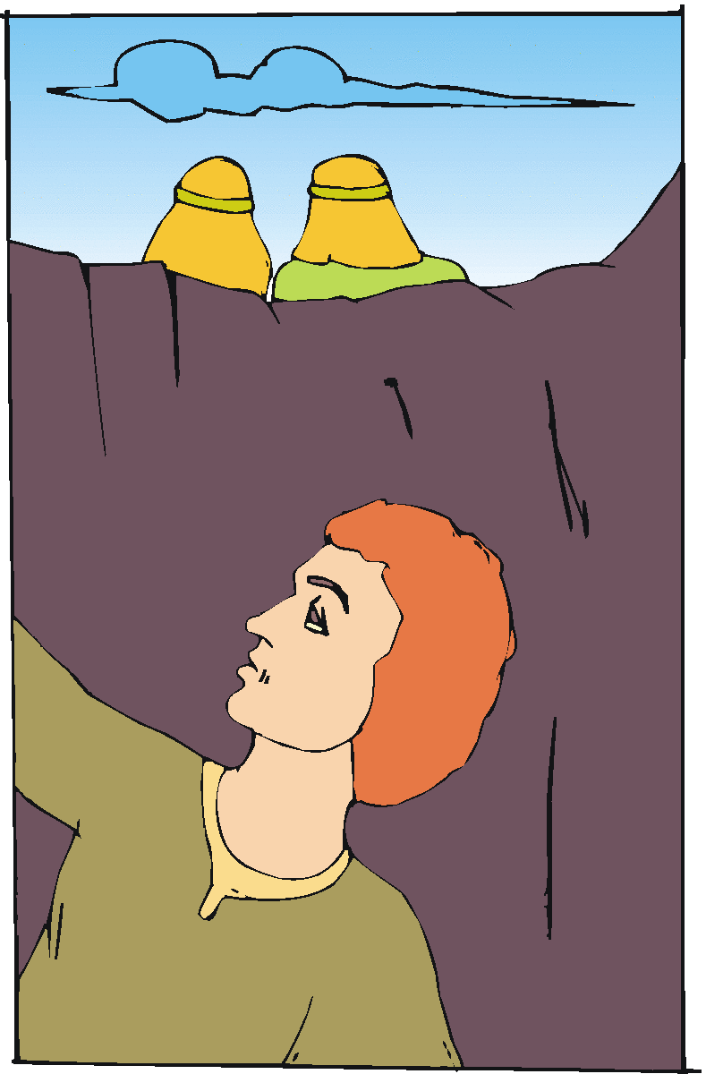
“Truly Guilty Concerning Our Brother”
Genesis 42
21 Then they said to one another, "We are truly guilty concerning our brother, for we saw the anguish of his soul when he pleaded with us, and we would not hear; therefore this distress has come upon us."

Slide 2
We May Be Guilty Concerning Our Brother By:
Wounding his feelings (Eph. 4:31-32; Prov. 15:1; Mt. 7:12)
Speaking evil of him (1 Pet. 2:1-2; Prov. 22:1)
Forsaking him in trouble (Lk. 10:30-37; Matt. 26:56; 2 Tim. 4:10)
Setting wrong example (Heb. 12:12-13; 1 Cor. 8:8-13)
Neglecting to pray for him (Jas. 5:16; Heb. 3:13; 3 Jn. 2)
Refusing to work to restore him (Gal. 6:1; Jas. 5:19-21)
What attitude do we have regarding our brother?

