Slide 1
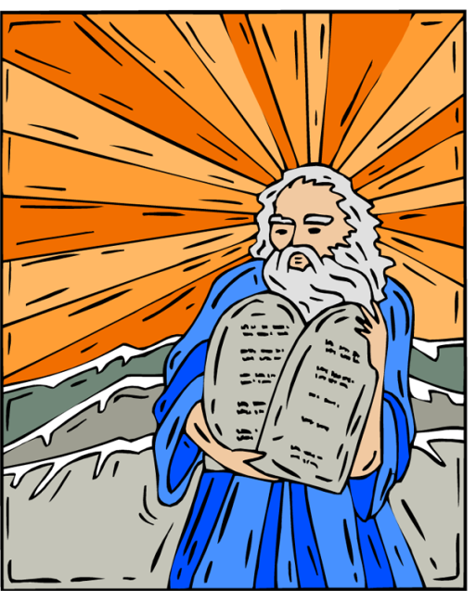
Veils – 2 Cor. 3:13-16
13 unlike Moses, who put a veil over his face so that the children of Israel could not look steadily at the end of what was passing away.
14 But their minds were blinded. For until this day the same veil remains unlifted in the reading of the Old Testament, because the veil is taken away in Christ.
15 But even to this day, when Moses is read, a veil lies on their heart.
16 Nevertheless when one turns to the Lord, the veil is taken away.

Slide 2
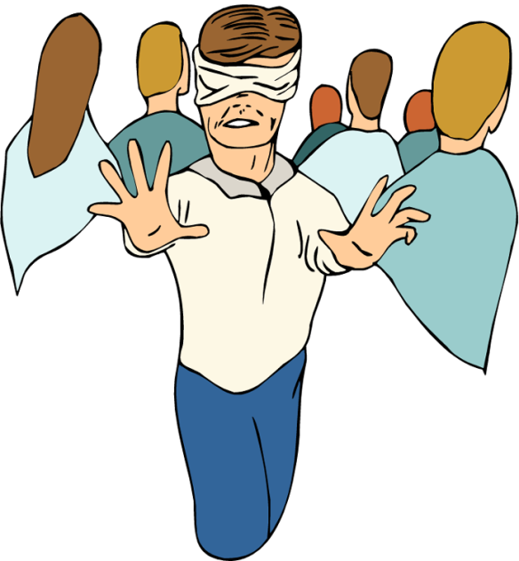
Could Not Look to the End→ Jesus
Could NOT See a Better Covenant (Heb. 8:6-13; 5:9).
Could NOT See Salvation In Christ for ALL Men (Rom. 10:1-4; Matt. 5:17-18).

Slide 3

Many Prophecies Seemed Contradictory
Messiah → Man and God
→ Suffering, yet Reigning
→ Dying and Ever-living
→ Mighty Prince, A King & A Man of Sorrows
Humble, yet Glorious
Seemed hard to reconcile until Christ came!
Ethiopian in darkness → Philip unveiled it for him (Acts 8:26-40).

Slide 4
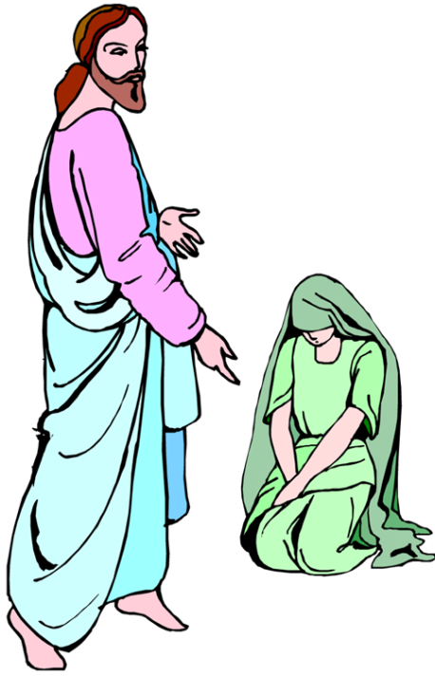
Jews: Still Blinded Today
Veil is NOT on the Law of Moses!
John 5:45 Do not think that I shall accuse you to the Father; there is one who accuses you--Moses, in whom you trust.
46 For if you believed Moses, you would believe Me; for he wrote about Me.
47 But if you do not believe his writings, how will you believe My words?"
Veil is on their heart!
2 Cor. 3:15 But even to this day, when Moses is read, a veil lies on their heart.

Slide 5

Satan Blinded Their Eyes
2 Cor. 4:3 But even if our gospel is veiled, it is veiled to those who are perishing, 4 whose minds the god of this age has blinded, who do not believe, lest the light of the gospel of the glory of Christ, who is the image of God, should shine on them.
NOT “god” because of divine attributes.
  The world pays him homage.
  He has the affections of their hearts.
  Man obeys his will, executes his plans.
  Ruler in the hearts and lives of men.
Satan has deceived or blinded the world into doing his will.

Slide 6
How Does Satan Blind the
Eyes of the World?
By False Reasoning (Gen. 3:4-5).
  “You’ll be like gods.”
  “This many people can’t be wrong.”
  “This is too good to be wrong.”
  “A ‘little’ sin won’t hurt.”
Envy (Jn. 11:48; Mk. 15:10).
Praise of Men (Jn. 12:42-43).
Family Ties (Matt. 10:34-38).
Materialism (Lk. 18:18-23).
  Demas (2 Tim. 4:10)
  Covetous heir (Lk. 12:13-21)
Physical Pleasures (2 Thess. 2:9-12).

Slide 7
More of Satan’s Veils
Veil of Tradition
  This veil is handed down: customs, beliefs.
  Pharisees guilty of this (Mt. 15:2-3; Mk. 7:1-5).
  Did what they were taught, but they were taught wrong!
  Warned against following traditions of men (Matt. 15:8-9; Col. 2:8).
    Infant baptism, Sprinkling for immersion…
    Instrumental music, Counting beads…
    Observing Holy Days, Wearing religious titles
  “We’ve always done it this way” is NOT Bible authority (Col. 3:17)!

Slide 8
More of Satan’s Veils
Veil of Prejudice or Pre-conceived Ideas
  Jews practiced racial prejudice (Acts 10:28; 11:15-17; 10:34-35).
    Contrary to Law of Christ (Gal. 2:11-14).
  Pre-judge → Make a judgments without the facts:
    “You can’t understand the Bible.”
      Eph. 3:3-4; 5:17; Rom. 1:16-17; 12:1-2
    “Make the Bible say anything you want it to.”
      Lk. 10:25-28; 2 Pet. 3:16
    “Baptism is not necessary for salvation.”
      Mk. 16:16; Acts 2:38; 22:16; 1 Pet. 3:21
    Naaman pre-judged (2 Kgs. 5:11; Ez. 12:2).

Slide 9
Veils Some Christians Wear
Believe “the end justifies the means.”
  Lost faith in the power of God’s Word to save.
    Social gospel→ day care centers, gyms, ball teams, field trips to recreational facilities, food, games, gimmicks…
    Another organization→ missionary society, college, sponsoring church…
  “Gospel meetings don’t do any good.”
  “Shorter sermons are more appealing.”
  “Bigger building, better parking, softer pews…”
    Either way you say it – its less gospel and more physical things to attract (Lk. 8:12).

Slide 10
Veils Some Christians Wear
Believe “evil company won’t corrupt.”
  1 Cor. 15:33; Prov. 24:1; Ps. 1:1-7
Believe “its alright to drink as long as you don’t get drunk.”
  Prov. 23:31; 1 Pet. 4:3; 2 Thess. 2:12
Believe “church discipline ineffective.”
  2 Thess. 3:6; 1 Cor. 7
1 And I, brethren, when I came to you, came not with excellency of speech or of wisdom, declaring unto you the testimony of God.
2 For I determined not to know any thing among you, save Jesus Christ, and him crucified.
3 And I was with you in weakness, and in fear, and in much trembling.
4 And my speech and my preaching was not with enticing words of man's wisdom, but in demonstration of the Spirit and of power:
5 That your faith should not stand in the wisdom of men, but in the power of God.
Our faith must be in the Word of God→ Not the philosophies, the traditions, or the things of this world (1 Cor. 2:1-5)!

