Slide 1

Wasted Prayers
9 Also He spoke this parable to some who trusted in themselves that they were righteous, and despised others:
10 "Two men went up to the temple to pray, one a Pharisee and the other a tax collector.
11 "The Pharisee stood and prayed thus with himself, 'God, I thank You that I am not like other men--extortioners, unjust, adulterers, or even as this tax collector.
12 'I fast twice a week; I give tithes of all that I possess.'
13 "And the tax collector, standing afar off, would not so much as raise his eyes to heaven, but beat his breast, saying, 'God, be merciful to me a sinner!'
14 "I tell you, this man went down to his house justified rather than the other; for everyone who exalts himself will be humbled, and he who humbles himself will be exalted."

Slide 2
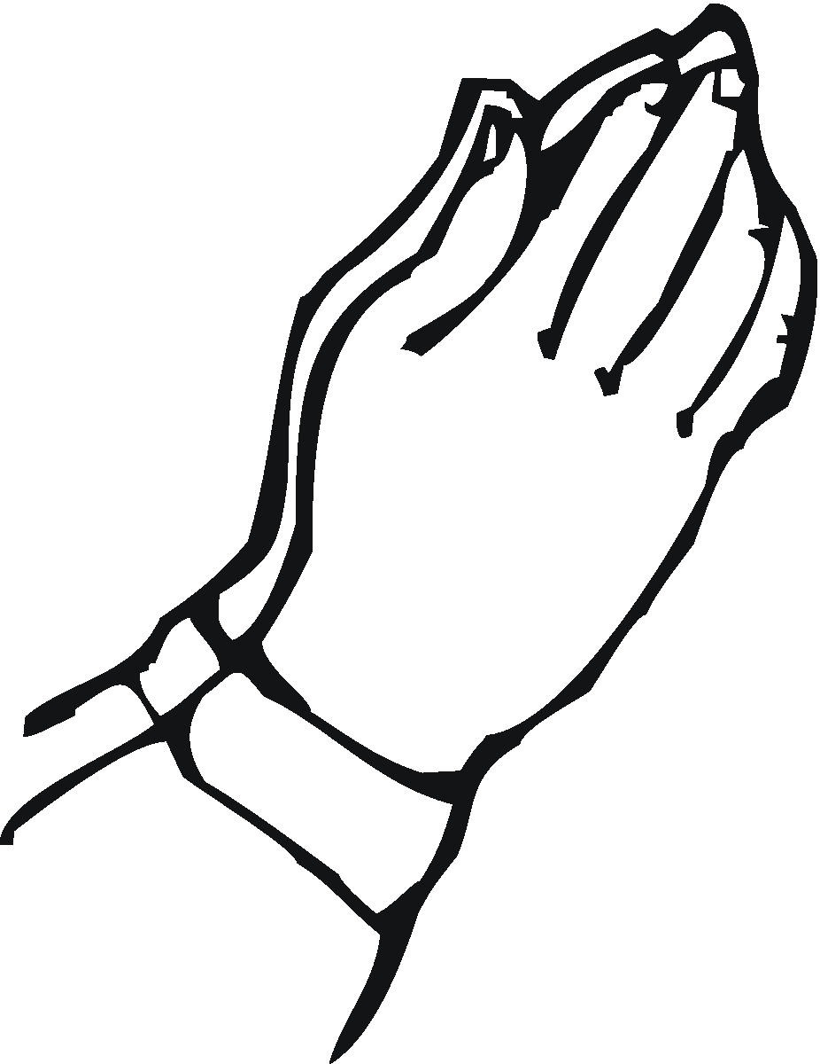
Wasted Prayer When Uttered:
For a substitute
  Prov. 28:9 One who turns away his ear from hearing the law, Even his prayer is an abomination.
  Jas. 5:16 Confess your trespasses to one another, and pray for one another, that you may be healed. The effective, fervent prayer of a righteous man avails much.
  1 Pet. 3:12 For the eyes of the LORD are on the righteous, And His ears are open to their prayers; But the face of the LORD is against those who do evil."
  Mk. 16:16 He who believes and is baptized will be saved; but he who does not believe will be condemned.

Slide 3
Wasted Prayer When Uttered:
By Sinners
  Jn. 9:31 Now we know that God does not hear sinners; but if anyone is a worshiper of God and does His will, He hears him.
  Isa. 1:15 When you spread out your hands, I will hide My eyes from you; Even though you make many prayers, I will not hear. Your hands are full of blood.
  16 Wash yourselves, make yourselves clean; Put away the evil of your doings from before My eyes. Cease to do evil,
  17 Learn to do good; Seek justice, Rebuke the oppressor; Defend the fatherless, Plead for the widow.

Slide 4
Wasted Prayer When Uttered:
By Sinners
  Isa 59:1 Behold, the LORD'S hand is not shortened, That it cannot save; Nor His ear heavy, That it cannot hear.
  2 But your iniquities have separated you from your God; And your sins have hidden His face from you, So that He will not hear.
  Prov. 15:29 The LORD is far from the wicked, But He hears the prayer of the righteous.

Slide 5
Wasted Prayer When Uttered:
Without Our Effort
  Matt. 6:11 Give us this day our daily bread.
  Jas. 1:6 But let him ask in faith, with no doubting, for he who doubts is like a wave of the sea driven and tossed by the wind. 7 For let not that man suppose that he will receive anything from the Lord;
  Lk. 6:46 But why do you call Me 'Lord, Lord,' and do not do the things which I say?
  Matt. 6:14 For if you forgive men their trespasses, your heavenly Father will also forgive you. 15 But if you do not forgive men their trespasses, neither will your Father forgive your trespasses.

Slide 6
Wasted Prayer When Uttered:
By the Self-Righteous
  Lk. 18:11 The Pharisee stood and prayed thus with himself, “God, I thank You that I am not like other men--extortioners, unjust, adulterers, or even as this tax collector.
  12 I fast twice a week; I give tithes of all that I possess.”
  13 And the tax collector, standing afar off, would not so much as raise his eyes to heaven, but beat his breast, saying, “God, be merciful to me a sinner!”
  14 I tell you, this man went down to his house justified rather than the other; for everyone who exalts himself will be humbled, and he who humbles himself will be exalted.
  Jas. 4:10 Humble yourselves in the sight of the Lord, and He will lift you up.

Slide 7
Wasted Prayer When Uttered:
For Wrong Motives
  Jas. 4:4 Adulterers and adulteresses! Do you not know that friendship with the world is enmity with God? Whoever therefore wants to be a friend of the world makes himself an enemy of God.
  Matt. 6:5 And when you pray, you shall not be like the hypocrites. For they love to pray standing in the synagogues and on the corners of the streets, that they may be seen by men. Assuredly, I say to you, they have their reward.
  6 But you, when you pray, go into your room, and when you have shut your door, pray to your Father who is in the secret place; and your Father who sees in secret will reward you openly.

Slide 8
Wasted Prayer When Uttered:
From Wrong Place
  1 Tim. 2:8 I desire therefore that the men pray everywhere, lifting up holy hands, without wrath and doubting;
  Lk. 16:29 Abraham said to him, ‘They have Moses and the prophets; let them hear them.’ 30 And he said, 'No, father Abraham; but if one goes to them from the dead, they will repent.’ 31 But he said to him, ‘If they do not hear Moses and the prophets, neither will they be persuaded though one rise from the dead.’
  Tit. 2:11 For the grace of God that brings salvation has appeared to all men, 12 teaching us that, denying ungodliness and worldly lusts, we should live soberly, righteously, and godly in the present age.

Slide 9
Wasted Prayer When Uttered:
At Wrong Time
  Matt. 25:11 Afterward the other virgins came also, saying, 'Lord, Lord, open to us!'
  Lk. 13:24 Strive to enter through the narrow gate, for many, I say to you, will seek to enter and will not be able.
  25 When once the Master of the house has risen up and shut the door, and you begin to stand outside and knock at the door, saying, 'Lord, Lord, open for us,' and He will answer and say to you, 'I do not know you, where you are from,'
  26 then you will begin to say, 'We ate and drank in Your presence, and You taught in our streets.'
  27 But He will say, 'I tell you I do not know you, where you are from. Depart from Me, all you workers of iniquity.'

Slide 10

Be Fervent In Prayer
Jas. 5:16 Confess your trespasses to one another, and pray for one another, that you may be healed. The effective, fervent prayer of a righteous man avails much.

