Slide 1
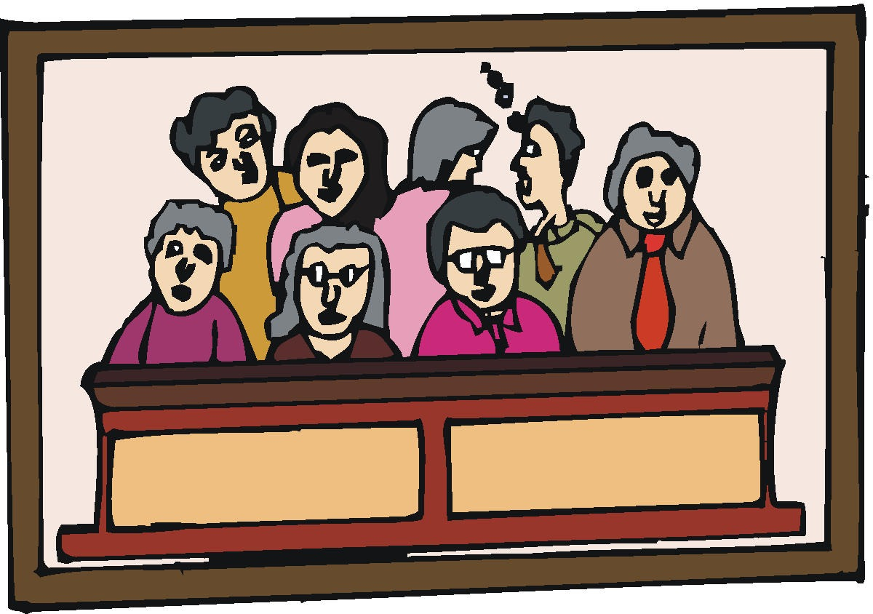
5 Witnesses
Jesus (Jn. 8:13-18)
John the Baptizer (Jn. 5:33; 1:29-34)
The Works of Jesus (Jn. 5:36; 3:2; Lk. 5:1-11)
The Father (Matt. 3:17; 17:5)
Moses (Jn. 5:46; Lk. 16:29-31)

Slide 2
12
Witnesses
(Acts 2)
30 Therefore, being a prophet, and knowing that God had sworn with an oath to him that of the fruit of his body, according to the flesh, He would raise up the Christ to sit on his throne,
31 he, foreseeing this, spoke concerning the resurrection of the Christ, that His soul was not left in Hades, nor did His flesh see corruption.
32 This Jesus God has raised up, of which we are all witnesses.
33 Therefore being exalted to the right hand of God, and having received from the Father the promise of the Holy Spirit, He poured out this which you now see and hear.
But you shall receive power when the Holy Spirit has come upon you; and you shall be witnesses to Me in Jerusalem, and in all Judea and Samaria, and to the end of the earth (Acts 1:8).

Slide 3
500 Witnesses
(1 Cor. 15)
3 For I delivered to you first of all that which I also received: that Christ died for our sins according to the Scriptures,
4 and that He was buried, and that He rose again the third day according to the Scriptures,
5 and that He was seen by Cephas, then by the twelve.
6 After that He was seen by over five hundred brethren at once, of whom the greater part remain to the present, but some have fallen asleep.
7 After that He was seen by James, then by all the apostles.
8 Then last of all He was seen by me also, as by one born out of due time.

Slide 4
How Many Witnesses Will It take To Convince You?
Matt. 11:20 Then He began to rebuke the cities in which most of His mighty works had been done, because they did not repent:
21 “Woe to you, Chorazin! Woe to you, Bethsaida! For if the mighty works which were done in you had been done in Tyre and Sidon, they would have repented long ago in sackcloth and ashes.
Jn. 12:42 Nevertheless even among the rulers many believed in Him, but because of the Pharisees they did not confess Him, lest they should be put out of the synagogue;
43 for they loved the praise of men more than the praise of God.

Slide 5
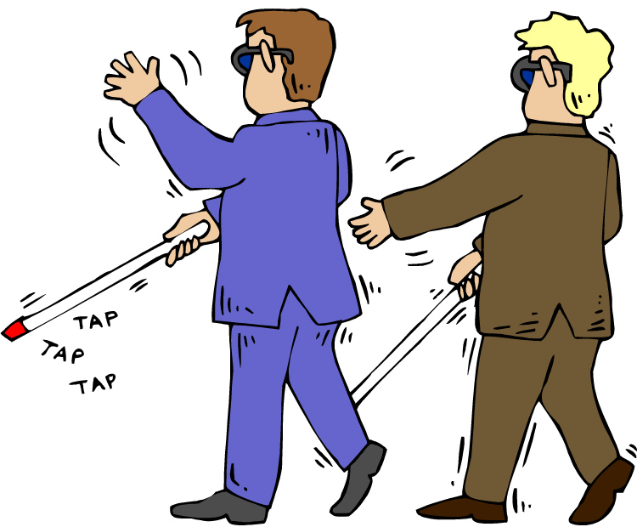
Don’t Let Satan
Blind You!
2 Cor. 4:3-4 But even if our gospel is veiled, it is veiled to those who are perishing, whose minds the god of this age has blinded, who do not believe, lest the light of the gospel of the glory of Christ, who is the image of God, should shine on them.
Jn. 9:35 Jesus heard that they had cast him out; and when He had found him, He said to him, “Do you believe in the Son of God?”
36 He answered and said, “Who is He, Lord, that I may believe in Him?”
37 And Jesus said to him, “You have both seen Him and it is He who is talking with you.”
38 Then he said, “Lord, I believe!” And he worshiped Him.

Slide 6
Believe the Witnesses of God: Be Saved Today!
Mk. 16:16 He who believes and is baptized will be saved; but he who does not believe will be condemned.
Acts 2:37 Now when they heard this, they were cut to the heart, and said to Peter and the rest of the apostles, “Men and brethren, what shall we do?”
38 Then Peter said to them, “Repent, and let every one of you be baptized in the name of Jesus Christ for the remission of sins; and you shall receive the gift of the Holy Spirit.

